Slide 1


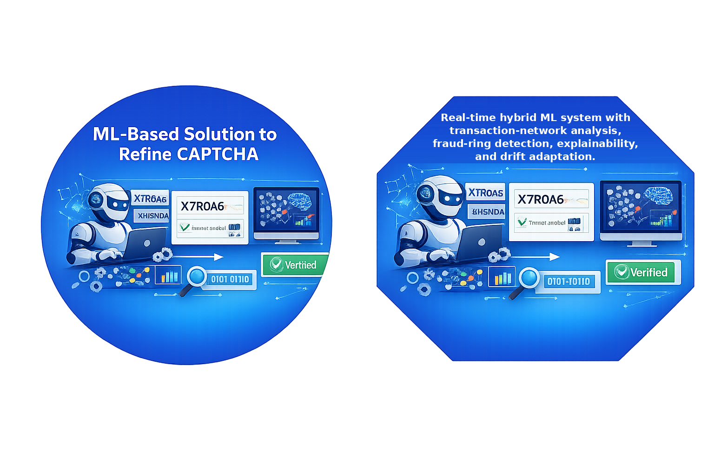



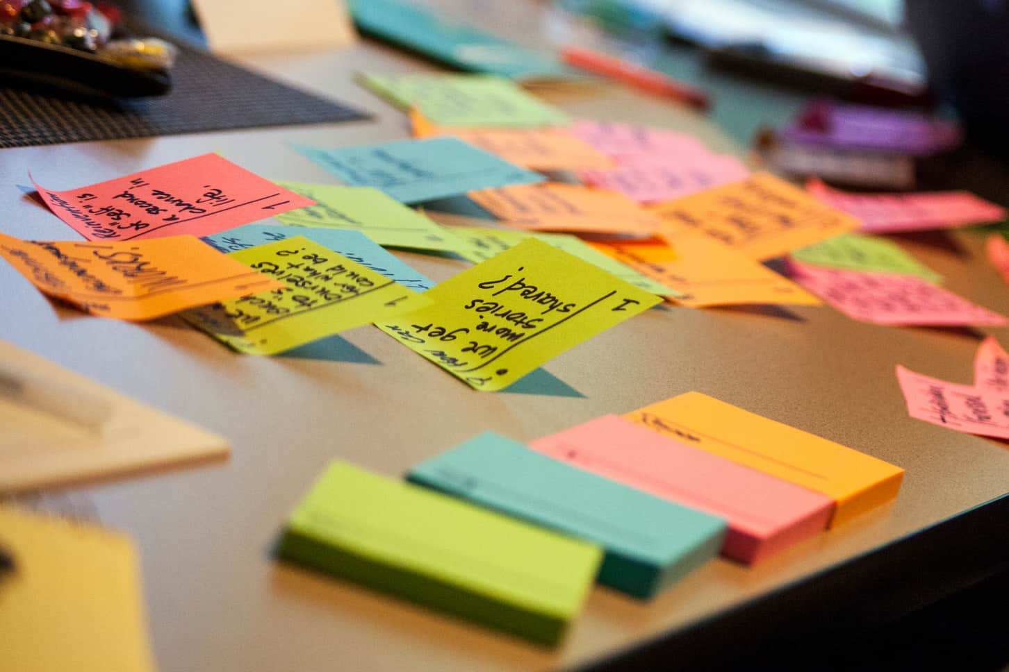


FINANCIAL FRAUD DETECTION AND TRANSACTION PATTERN ANALYSIS USING ML
PRESENTATION 2026
Student Name
Student Email
Guide
K.Manasa
K.Rakshitha
B.Akshitha
manasakunja11@gmail.com
karrerakshitha944@gmail.com
akshithaboragala@gmail.com
R.Manoj Kumar (SME)

Slide 2
OUTLINE
Abstract of the Project
Problem Statement
Proposed Solution
System Architecture
Hybrid ML Detection Models
Live Demo of the Project
Embedded Video of Project
Performance Evaluation Metrics
Insights And Recommendations
Conclusion
Future Scope

Slide 3
Abstract
This project develops a hybrid ML-based financial fraud detection system using the PaySim dataset.It addresses highly imbalanced, complex, and continuously changing transaction data, where traditional methods may fail to detect evolving fraud patterns and relationships between suspicious accounts. XGBoost detects fraudulent transactions, while transaction graphs and TGN analyze transaction relationships and patterns. SHAP provides explainability, community detection identifies potential fraud rings, and ADWIN detects changing transaction patterns. A hybrid ML system, it detects fraudulent transactions, identifies potential fraud rings, provides explainable predictions, and monitors changing transaction patterns.The results are presented through a Streamlit dashboard for interactive fraud analysis and monitoring.

Slide 4
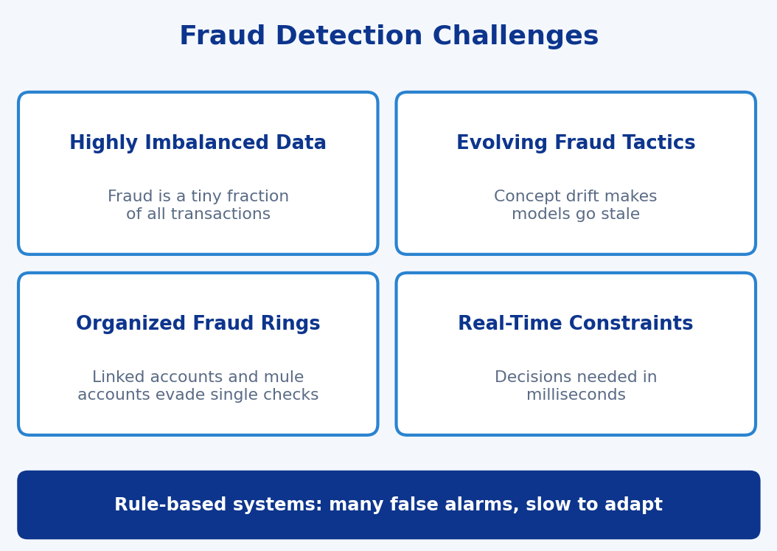
Problem Statement
Current fraud detection systems face challenges in accurately identifying fraudulent transactions due to highly imbalanced, complex, and continuously changing financial transaction data.
Traditional methods may fail to detect evolving fraud patterns and relationships between suspicious accounts.
Therefore, there is a need for a hybrid ML-based system that can detect fraudulent transactions, identify potential fraud rings, provide explainable predictions, and monitor changing transaction patterns.

Slide 5
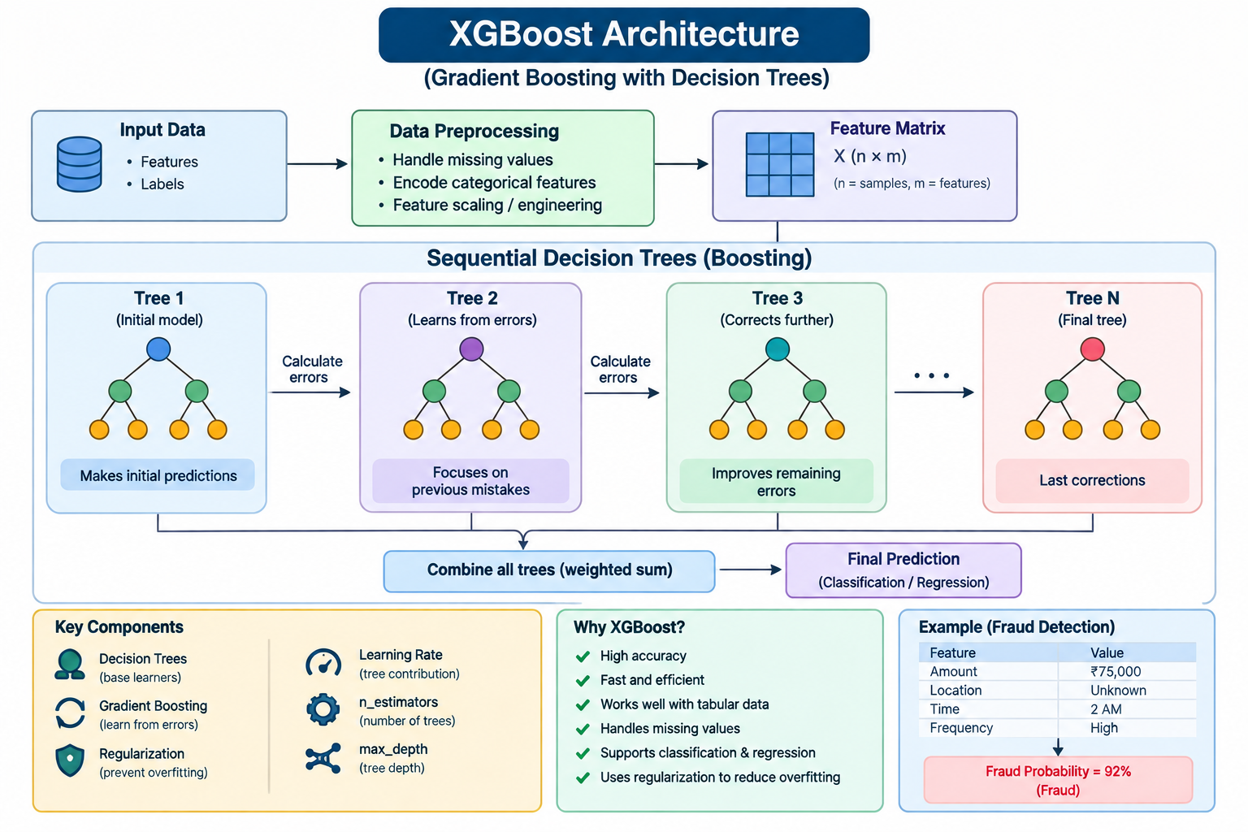
XGBoost
XGBoost – More Matter for Your Project
XGBoost (Extreme Gradient Boosting) is a powerful machine learning algorithm based on decision trees. It is widely used for classification and prediction problems. In our project, “Financial Fraud Detection and Transaction Pattern Analysis Using ML,” XGBoost is used to identify whether a financial transaction is legitimate or fraudulent.
How XGBoost works
XGBoost builds multiple decision trees sequentially. Each new tree tries to correct the errors made by the previous trees. Finally, the predictions from all trees are combined to produce the final result.
Process:
Transaction Data → Data Preprocessing → Feature Selection → XGBoost Model → Fraud Prediction → Result

Slide 6
Advantages
High prediction accuracy
Handles large datasets efficiently
Works well with structured/tabular data
Can handle complex relationships between features
Provides feature-importance information
Supports classification and regression
Includes regularization to reduce overfitting
Disadvantages of XGBoost
Complex model interpretation
High memory usage
Training can be time-consuming
Sensitive to noisy data
Not suitable for every type of data
Requires good-quality features
More complex than simple ML algorithms

Slide 7
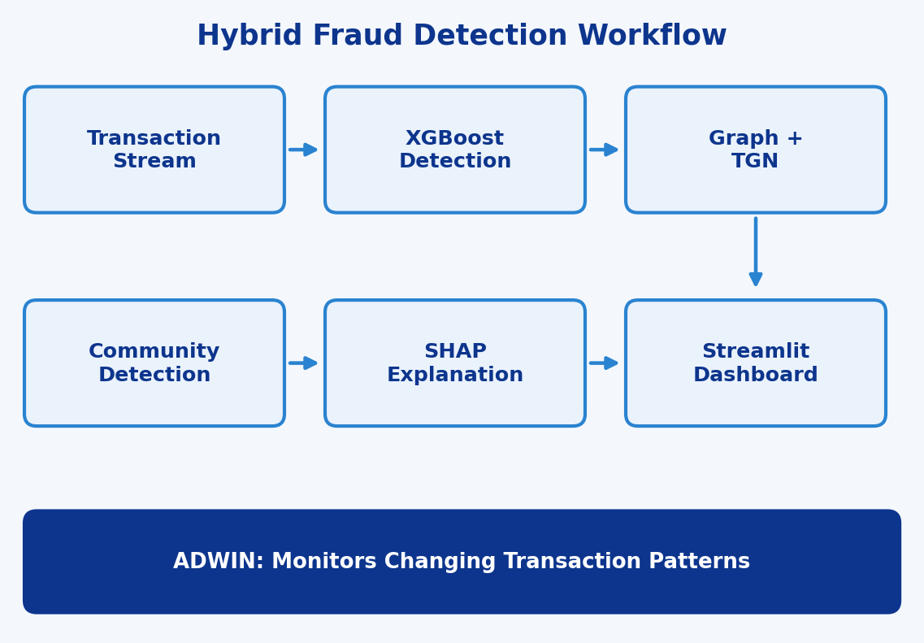
Proposed Solution
The proposed system is a real-time hybrid ML system that combines multiple techniques for financial fraud detection.
XGBoost: Detects fraudulent transactions.
Transaction Graphs and TGN: Analyze relationships and temporal transaction patterns.
Community Detection and SHAP: Community detection identifies potential fraud rings, while SHAP provides explainable predictions.
ADWIN: Monitors changing transaction patterns.
Streamlit Dashboard: Integrates the results for interactive fraud detection and analysis.

Slide 8
System Architecture
Data Processing Module
Fraud Detection Module
Prepares the PaySim transaction data and features for model training and analysis.
XGBoost classifies each transaction as fraudulent or legitimate.
Graph Analysis Module
Explainability & Monitoring Module
Builds transaction graphs, applies TGN, and uses community detection to identify potential fraud rings.
SHAP explains predictions, ADWIN detects changing patterns, and the Streamlit dashboard presents the results.

Slide 9
HYBRID ML DETECTION MODELS
The detection system is a hybrid ML pipeline built on the PaySim dataset. It combines XGBoost for fraud classification with graph-based analysis of transaction relationships and patterns, along with explainability and drift monitoring.
Components of the Hybrid Detection System :
XGBoost Classifier: Detects fraudulent transactions from transaction features.
Transaction Graph: Represents accounts and transactions as a graph to capture relationships between them.
TGN (Temporal Graph Network): Analyzes temporal transaction patterns and how account relationships change over time.
Community Detection: Groups closely connected accounts to identify potential fraud rings.
SHAP: Explains each prediction by showing which features contributed to it.

Slide 10
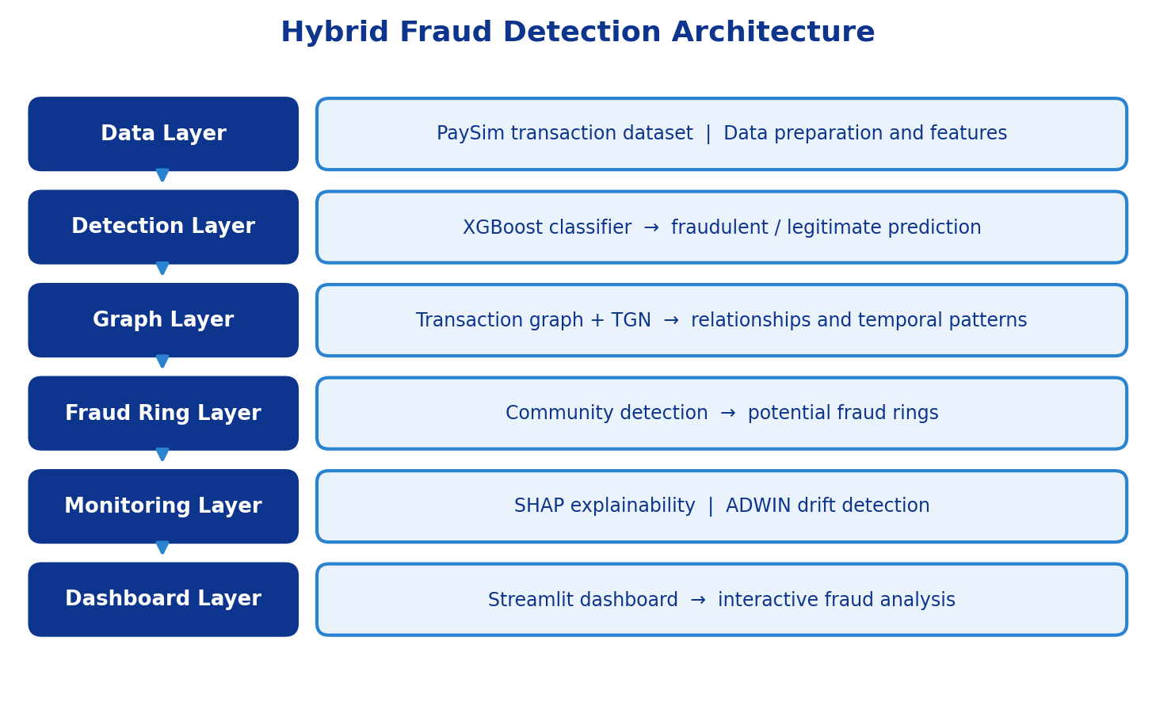
ADWIN: Adaptive Windowing monitors the transaction stream and detects changing transaction patterns.
Streamlit Dashboard: Integrates the results for interactive fraud analysis and monitoring.

Slide 11

LIVE DEMO OF PROJECT

Slide 12
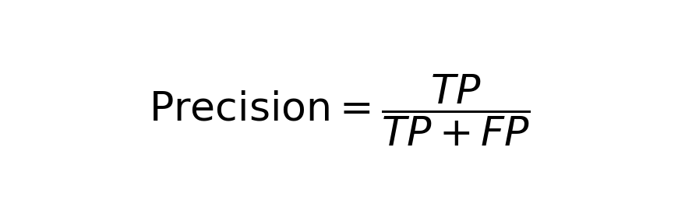
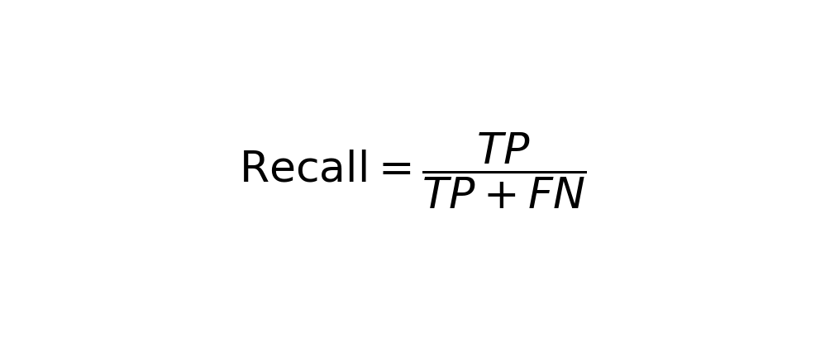
Performance Evaluation Metrics
1. Precision: Shows how many transactions flagged as fraud are actually fraudulent.
2. Recall: Shows how many of the actual fraudulent transactions the model successfully detects.

Slide 13


3. F1-Score: Harmonic mean of precision and recall, giving a balanced measure on highly imbalanced fraud data.
4. PR-AUC: Area under the precision-recall curve; summarizes performance on the rare fraud class.

Slide 14
Precision = 99.87%
TP = 3,084, FP = 4
Calculation: 3,084 / 3,088 = 0.9987
2. Recall = 72.50%
TP = 3,084, FN = 1,170
Calculation: 3,084 / 4,254 = 0.7250
3. F1-Score = 84.01%
Calculation: 2 _ (0.9987 _ 0.7250) / (0.9987 + 0.7250) = 0.8401
4. PR-AUC = 96.24%
PR-AUC = Area Under the Precision-Recall CurveValue = 0.9624 = 96.24%

Slide 15
Insights And Recommendations
Insights
Combining XGBoost with transaction graphs and TGN captures both individual transaction behavior and the relationships between accounts.
Community detection helps identify potential fraud rings, and SHAP makes predictions explainable so analysts can see why a transaction is flagged.
ADWIN detects changing transaction patterns, helping the system stay relevant as fraud behavior evolves.
Recommendations
Evaluate the system with precision, recall, F1-score, and PR-AUC rather than accuracy, since fraud data is highly imbalanced.
Update or retrain the models whenever ADWIN signals a change in transaction patterns.
Validate the system on real-world transaction data beyond PaySim and integrate it with real-time transaction streams.

Slide 16
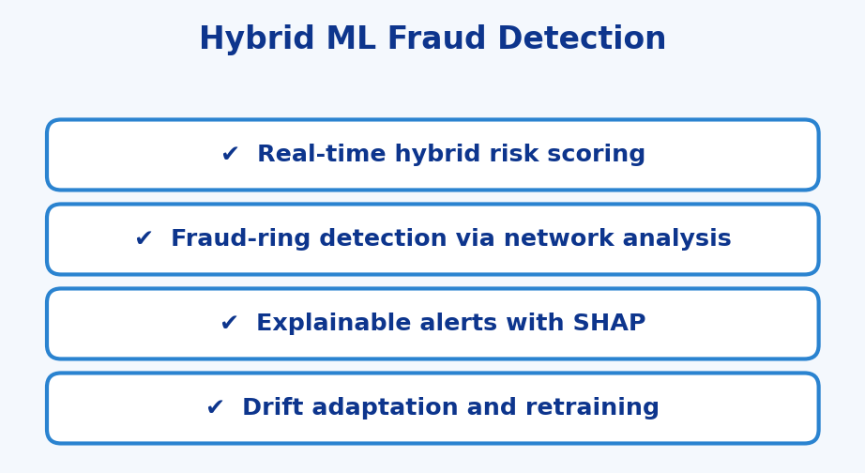
Conclusion
The project delivers a real-time hybrid ML system for Our project,
Financial Fraud Detection and Transaction Pattern Analysis,
uses a hybrid approach to detect and analyze financial fraud.
XGBoost is used to identify fraudulent transactions, while
Temporal Graph Network (TGN) analysis helps study
transaction relationships and connected accounts to identify
possible fraud patterns and groups. SHAP provides explanations
for the model's predictions, making fraud alerts easier to
understand. ADWIN-based drift monitoring helps detect
changes in fraud patterns over time and supports model
adaptation. Overall, our approach combines fraud detection,
transaction-network analysis, explainability, and drift
monitoring to provide a more adaptive and scalable solution for
modern financial fraud detection.

Slide 17
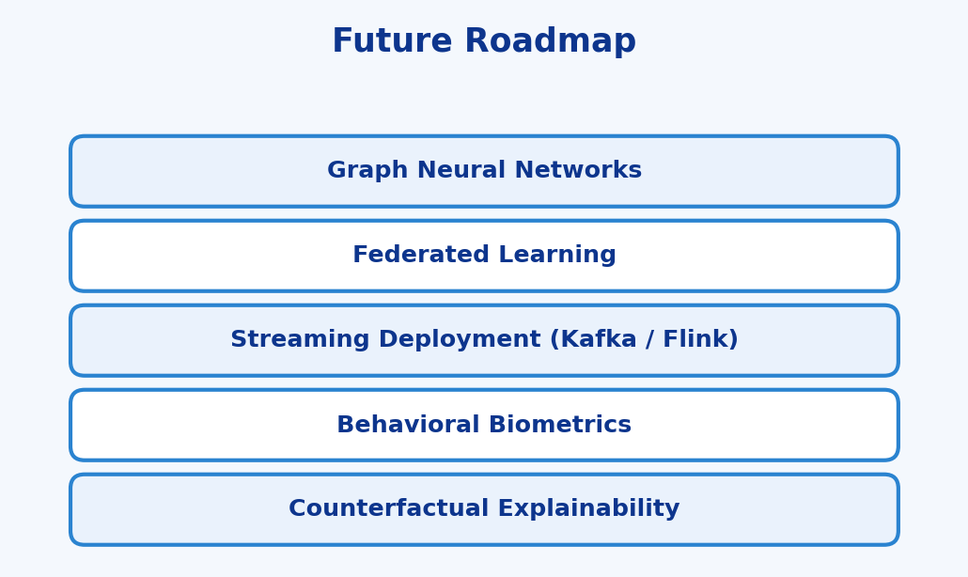
Future Scope
Integration of graph neural networks (GNNs) for deeper fraud-ring and network-level detection.
Implementation of federated learning to train across banks without sharing raw customer data.
Development of streaming deployment with Kafka or Flink for sub-second, high-throughput scoring.
Integration with behavioral biometrics and device intelligence for stronger authentication.
Deployment on large-scale banking platforms with cloud-based scalability.
Enhancement using advanced explainability such as counterfactual explanations for analysts.
Incorporation of Transformer-based or sequence models to capture long-term customer transaction behavior.

Slide 18
Thank You
Notes:
thank you very much for joining this PPT, keep learning.
18

